Slide 1

Portfolio Executive Committee (PEC) Review Meeting
TA ONCOLOGY
To insert a wordmark:
Add (e.g. via drag and drop) your wordmark file (in RGB) to this slide (in alignment with our brand governance and architecture guidelines)
Change the size of the wordmark according to the height reference (magenta placeholder)
Select the “guides” in the navigation bar and move the wordmark to the right and top line (orange)
  Oncology Team | 23-Apr-2026 | 20 mins

Slide 2
Actions from last PEC meeting
Follow up actions | Owner | Due Date | Status update | Completed (Y/N)
Zongertinib-1L NSCLC: To evaluate the NDA approval timeline after the inspection feedback is transferred to CDE from CFDI and reviewed by CDE (expected around early April) . | Zongertinib LPT | Apr PEC | To be covered in the program update. | Y
Zongertinib-IIS: To reconfirm with China commercial team regarding the IMP supply (200 kits) for this study. | Sally Chen | Apr PEC | Confirmed – 200 kits for 2026. | Y
Zongertinib-RWE study: To document the communication with HAMA team regarding the different definitions of PFS & OS between RWE study and clinical study. | Yuhui Huang | Apr PEC | Informed the HAMA team of the different definitions at the meeting and emphasized them in the email sharing preliminary results of the RWE study. | Y

Slide 3
Part I: Portfolio Update

Slide 4


TA ONC Portfolio Summary - Pipeline Project
Launched
Ongoing/under planning
Under evaluation
Zongertinib
2L NSCLC
1L NSCLC
Adjuvant NSCLC
Pan-Tumor HER2m
Pan-Tumor HER2+
3L+ BC
1L CRC
2L BC
2L GC
Next wave
KRAS^{multi} degrader
CRC; NSCLC; PDAC
HPK1 Degrader
RCC; NSCLC; HNSCC
Anti-LAYN antibody
Solid tumors
LY6K-HLA/CD3
NSCLC; HNSCC
CD137/FAP
HNSCC
Non-CDN STING FR
1L sqNSCLC
VSV-GP-GSDME-IL12
TNBC
TAG72/CD3 ADC
GC; NSCLC; OC
B7-H6/CD3
CRC
KRAS G12D inh.
CRC
BTN3A/CLDN6 gamma-delta TcE
OV; EC; TC; LC; GC
SIRPα NG
HNSCC
VSV-GP
PDAC; HNSCC; Melanoma
YE IL2-IFNa
TNBC
Obrixtamig
2L epNEC
1L epNEC
1L SCLC
CDCP-1 ADC
NSCLC
YE-cGAS/RIG1
HNSCC; Melanoma
ALPG/CD3 TcE
Solid tumors
ODC-IL12
Melanoma
KISIMA-02
Stop/Park
CS - FiH
FiH - PoC
Post PoC
Sustain
KRAS^{multi} degrader:
Discontinuation of the Front Runner compound due to much more favorable tox profile in the Backup compound
Re-direct CMC investment and activity towards the backup compound
Notes:
mannual

Slide 5
2026 ONC Key Milestone Overview
We are here
Global milestones
IA for SIRPa antago.- HNSCC Ph1b
Key result for STING -1L sqNSCLC Ph1a
RoFD fo Zongertinib 1L CRC
FA for Obrixtamig - 2L epNEC Dareon-5
FA for CD137/Fap - NSCLC Ph1b
FDA Approval for Zongertinib 1L NSCLC (2/26/2026)
PoCP for VSV-GP - PDAC
Pre-FiH IP
for KRAS G12D Ph1
POC for CD137/Fap - HNSCC
RoFD fo Zongertinib 2L GC
POC for SIRPa antago.- HNSCC
JAN | FEB | MAR | APR | MAY | JUN | JUL | AUG | SEP | OCT | NOV | DEC
1st SIV for Zongertinib - Adjuvant NSCLC Beamion LUNG-3
NDA approval - Zongertinib 1L NSCLC (Best)
CTA Sub. for
STING -1L sqNSCLC Ph1b/2
1st SIV for Zongertinib - NSCLC Combo study
CTA Sub. for
CD137/Fap - NSCLC Ph1b
Key results for Zongertinib 1L NSCLC Beamion LUNG-2
CTA Sub. for
Zongertinib - BCGC CTP amend.
Inspection for
Zongertinib 1L NSCLC NMPA *2.
HAI for Zongertinib - Pantumor development (Q2)
HAI for Zongertinib –
2L post-marketing requirements (Q2)
1st SIV for Obrixtamig - 1L epNEC Dareon-Nec-1
CTA Sub. for
Obrixtamig -1L epNEC Ph3
CTA Sub. for
Obrixtamig -2L epNEC CTP amend.
HAI for Obrixtamig - 2L epNEC Dareon-5 after futility analysis (Q1/2)
Key results for Zongertinib Beamion LUNG-1 cohort 9
1st SIV for Obrixtamig - 1L SCLC Dareon-Lung1
BTD Sub. for Obrixtamig - 2L epNEC Dareon-5 after futility analysis (Q1/2)
China milestones
CS/PoC/RoFD
Termination
Go-Nogo IP/IA/FA/Key result/TLR
Pre-IND/CTA/SIV
BTD/NDA/Inspection

Slide 6
Part II: Project Update

Slide 7
Zongertinib (BI 1810631, HER2 TKI)
P1-Lung

Slide 8


Zongertinib (HERNEXEOS®) – 1L NSCLC Development Plan_AA
We are here
2023 |  |  |  | 2024 |  |  |  | 2025 |  |  |  | 2026 |  |  |  | 2027 |  | 2028
Q1 | Q2 | Q3 | Q4 | Q1 | Q2 | Q3 | Q4 | Q1 | Q2 | Q3 | Q4 | Q1 | Q2 | Q3 | Q4 | H1 | H2 | H1 | H2
Ph Ia/b
1479-0001
Beamion LUNG-1
Sep 2025
Jun 2024
May 2025
30 Sep
2025
Feb 2026
US approval on Feb 26, 2026
Ph Ib cohort 2
N=74
FPI
LPI
TLR
NDA sub.
NDA app.
Jul 2025
BTD sub.
Sep 2025
Jun 2024
May 2025
29 Oct 2025
June 2026
Ph Ia/b
1479-0001
Beamion LUNG-1
Ph Ib cohort 2
N=18
FPI
LPI
TLR
NDA sub.
NDA app
Aug 2025
Pre-NDA sub.
CFDI completed the GCP inspection assessment report and CDE registered the GCP inspection report on April 9, 2026
Response to CDE GCP related queries was submitted on April 20.
Aug 2025
BTD granted
AA: Accelerated approval; CNPV: Commissioner’s National Priority Voucher
STRICTLY CONFIDENTIAL

Slide 9

Key Milestones of Zongertinib 1L NSCLC NDA(with PR)
We are here
2025 |  |  |  | 2026
Sep | Oct | Nov | Dec | Jan | Feb | Mar | Apr | May | Jun | Jul | Aug
Sub:
29-Oct -25
Without DL-7m
CDE Technical review（1st round review,130WD）
Nov-25 to May-26
NMPA approval*
Accept.
:31-Oct-25
GCP Inspection
Feb 2026 to Apr 2026
Rolling submission:
Updated 12m efficacy and safety data
Updated CNPI based on CCDS0305-05
Rolling submission:
Exposure efficacy and safety report;
272 summary;
Pop PK report( only as request)
1479-0020 CTR
Rolling submission:
1st rolling submission : already submitted to CDE website and completed formal submission as approach of e-CTD.
2th rolling submission: already submitted to CDE website and wait for CDE agreement formal submission
GCP inspection:
CFDI completed the GCP inspection assessment report on April 8 with a conclusion of "passed, please CDE pay attention during review(通过，需审评重点关注)," CDE registered the GCP inspection report on April 9 .
Queries:
Until 13-Apr, received 4 queries from clinical reviewer, 4 verbal queries from Statistical Reviewer,4 queries from clinical pharmacology reviewer.
* If CDE trigger deficiency letter, then approval may be in Aug 2026

Slide 10
Zongertinib (HERNEXEOS®) – 1L NSCLC Development Plan_ Full Approval
We are here
2024 |  |  |  | 2025 |  |  |  | 2026 |  |  |  | 2027 |  |  |  | 2028
Q1 | Q2 | Q3 | Q4 | Q1 | Q2 | Q3 | Q4 | Q1 | Q2 | Q3 | Q4 | Q1 | Q2 | Q3 | Q4 | Q1 | Q2 | Q3 | Q4
Ph3
1479-0008
Beamion LUNG-2
Jan 2024
Jan 2026
Nov 2026
Mar 3 2027
Jul 2027
Ph 3 N=416
FPI
LPI
TLR
sub.
app.
PMA (Plan Meeting A) will take place during Apr 22 to 23, 2026.
Mar 2024
Jan 2026
Nov 2026
Apr 2 2027
Apr 2028
Ph3, N=88
Ph3
1479-0008
Beamion LUNG-2
1st SIV
LPI
TLR
sub.
app.
Local needs (e.g. subgroup outputs, post-marketing requirements) will be discussed during PMA.
* 1L NDA based on 12-month review period
10

Slide 11
HER2 Non-TKD Mutant Population
2L NSCLC AA Post Marketing Requirement in China
Global Status
China Status
The pre-sNDA/Type B meeting package for zongertinib (Cohort 3/non-TKD) was submitted to the FDA on April 1, 2026.
This Type B Meeting was granted, by the FDA, as a teleconference for May 5, 2026.
Need to align within global brand team
Will keep China team posted
China local team prefer to re-open Cohort 3 and the local position has been discussed with global team
Briefing book for pre-IND meeting is under reviewing by global team and local CEC members. Will submit the meeting request after FDA feedback received (May/Jun, 2026).

Slide 12
Zongertinib (HERNEXEOS®) – Adjunctive NSCLC Development Plan
We are here
2025 |  |  |  | 2026 |  |  |  | 2027 |  | 2028 |  | 2029 |  | 2030 |  | 2031 |  | 2032
Q1 | Q2 | Q3 | Q4 | Q1 | Q2 | Q3 | Q4 | H1 | H2 | H1 | H2 | H1 | H2 | H1 | H2 | H1 | H2 | H1 | H2
Nov 2025
Nov 2029
Oct 2030
Feb
2031
Jun
2031
Ph3
1479-0032
Beamion LUNG-3
Ph3, N=400
FPI
LPI
Key results
NDA
sub.
NDA
app.
Enrollment status : 4 pt enrolled globally
Aug 2025
5 Jan 2026
Nov 2029
Oct 2030
Mar
2031
Jan
2032
CTA Review + EC + HGRAC + 1st SIV
Ph3, N=70
Ph3
1479-0032
Beamion LUNG-3
1st SIV
LPI
Key results
NDA sub.
NDA app.
CTA Sub
Enrollment status 3 enrolled
Initiated site: 22 site
12

Slide 13
Global Recruitment Status
Description | Count
Molecular screened | 16
Screened | 9
Screen-Failed | 1
Randomized | 4
Ongoing | 4
Long-term FU | -

Slide 14
1479-0032 Zongertinib Beamion LUNG-3 on 22Apr2026 (China recruitment status)
Description | Global | China
Molecular screened | 16 | 3
Screened | 9 | 3
Screen-Failed | 1 | -
Randomized | 4 | 3
Ongoing | 4 | 3
Long-term FU | -
Months | Jan-26 | Feb-26 | Mar-26 | Apr-26 | May-26 | Jun-26 | Jul-26 | Aug-26 | Sep-26 | Oct-26 | Nov-26 | Dec-26 | Jan-27 | Feb-27 | Mar-27 | Apr-27 | May-27 | Jun-27 | Jul-27 | Aug-27 | Sep-27 | Oct-27 | Oct-27 | Nov-27 | Dec-27 | Jan-28 | Feb-28 | Mar-28 | Apr-28 | May-28 | Jun-28 | Jul-28 | Aug-28 | Sep-28 | Oct-28 | Nov-28 | Dec-28 | Jan-29 | Feb-29 | Mar-29 | Apr-29 | May-29 | Jun-29 | Jun-29 | Jul-29 | Aug-29 | Sep-29 | Oct-29 | Nov-29
Pts randomized (actual) | 1 | 1 | 1 | 3
Pts randomized (plan) | 1 | 2 | 3 | 4 | 6 | 7 | 9 | 10 | 12 | 13 | 15 | 16 | 17 | 18 | 20 | 21 | 23 | 24 | 26 | 27 | 28 | 30 | 31 | 33 | 34 | 36 | 37 | 39 | 40 | 41 | 43 | 44 | 46 | 47 | 48 | 49 | 51 | 53 | 54 | 56 | 57 | 59 | 60 | 62 | 63 | 65 | 67 | 69 | 70
Pts screened (actual) | 1 | 1 | 2 | 3
Pts screened (planl) | 1 | 2 | 3 | 4 | 6 | 8 | 10 | 12 | 14 | 16 | 18 | 20 | 22 | 24 | 26 | 28 | 30 | 32 | 34 | 36 | 38 | 40 | 42 | 44 | 46 | 48 | 50 | 52 | 54 | 56 | 58 | 60 | 62 | 64 | 66 | 68 | 70 | 72 | 74 | 76 | 78 | 80 | 82 | 84 | 86 | 88 | 90 | 92 | 94
Clinical Development
and Operations

Slide 15
Zongertinib (HERNEXEOS®) – 1L NSCLC Combo
We are here
2025 |  |  |  | 2026 |  |  |  | 2027 |  | 2028 |  | 2029 |  | 2030 |  | 2031 |  | 2032
Q1 | Q2 | Q3 | Q4 | Q1 | Q2 | Q3 | Q4 | H1 | H2 | H1 | H2 | H1 | H2 | H1 | H2 | H1 | H2 | H1 | H2
May 2026
Aug 2027
2028
Ph2
1479-0044
Beamion 44
Ph2, N=60
FPI
LPI
Key results
Further development plan
Jan 2026 *
Jun 2026
Aug 2027
2028
CTA Review + EC + HGRAC + 1st SIV
Ph2, N=8
Ph2
1479-0044
Beamion 44
1st SIV
LPI
CTA Sub
Key results
CTA approved on Mar 20, 2026, in ahead of schedule
HGRAC submission on 16Apr2026.
SIV expected in Jun 2026 (CoC of SoC not released yet.)
*
15

Slide 16
Zongertinib (BI 1810631, HER2 TKI)
P2- Non-Lung

Slide 17
General update
  New TPP(Early stage breast cancer) proposal : Early Stage Breast Cancer development plans, draft TPPs, prelimnary study designs are progressing , this new TPP proposal will submit to HPBUPC for endorsement in May​.
  1L CRC development : Beamion CRC-1 (1479-0050) TDO kicked off.
  2L BC strategy revision ongoing & alignment with Jazz​
  BCGC-01 amendment to be frontloaded (Cohort P : Zongertinib + Zanidatamab + Taxane , 2L mBC)

Slide 18
Zongertinib (HERNEXEOS®) – Pan-tumor Development Plan (Accelerate Approval)
We are here
2024 |  |  |  | 2025 |  |  |  | 2026 |  |  |  | 2027 |  |  |  | 2028 |  |  |  | 2029
Q1 | Q2 | Q3 | Q4 | Q1 | Q2 | Q3 | Q4 | Q1 | Q2 | Q3 | Q4 | Q1 | Q2 | Q3 | Q4 | Q1 | Q2 | Q3 | Q4 | H1 | H2
Oct 2024
Sep 2027
Dec 2027
Aug 2028
Ph2
1479-0009
Beamion Pan tumor-1
Ph2, N=430
FPI
LPI
Key results
NDA app. AA – HER2 amplified and mutant cohorts
CTPv4.0 was finalized and CTP v4 will be implemented after health authority’s approval.
Health authority interaction(CDE、PMDA, etc) of Beamion Pantumor-1 is ongoing.
Apr 2028
NDA sub HER2 amplified
and mutant cohorts
May 2024
Oct 2024
Sep 2027
Dec 2027
Mar 2029
CTA Review + EC + HGRAC + 1st SIV
Ph2, N=40
CTA Sub
SIV
LPI
Key results
NDA app. AA – HER2 amplified and mutant cohorts
Ph2
1479-0009
Beamion Pan tumor-1
May 2028
NDA sub HER2 amplified
and mutant cohorts
Totally 18 subjects were enrolled; Totally 11 Chinese sites will be selected under CTP V4.
Health authority interaction was submitted to CDE on Apr-10, 2026, expect written feedback received by Jul-07, 2026.
18

Slide 19
Global Recruitment Status (as of 17-Apr-2026)
Clinical Development
and Operations

Slide 20
China Recruitment Status (as of 17-Apr-2026)
Clinical Development
and Operations

Slide 21
Zongertinib (HERNEXEOS®) – Breast Cancer & Gastric Cancer (BC&GC)
We are here
2024 |  | 2025 |  |  |  | 2026 |  |  |  | 2027 |  |  |  | 2028 |  |  |  | 2029 |  |  |  | 2030
H1 | H2 | Q1 | Q2 | Q3 | Q4 | Q1 | Q2 | Q3 | Q4 | Q1 | Q2 | Q3 | Q4 | Q1 | Q2 | Q3 | Q4 | Q1 | Q2 | Q3 | Q4 | H1
July 2024
Apr 2028
Oct 2028
Jun 2029
Ph Ib/2-
1479-0012
Beamion BCGC-1
Ph1b/2, N=768
FPI
Key results
NDA app.
BC 3L+ AA
LPI
Feb 2029
NDA sub.
2L BC strategy revision is ongoing with an new cohort (Zongertinib + Zanidatamab + Taxane)
Phase II recruitment (Cohorts D,E,F,I,J) opened.
Jan 2024
July 2024
Apr 2028
Oct 2028
Jan 2030
CTA Review + EC + HGRAC + 1st SIV
Ph1b/2, N=72
Mar 2029
SIV
LPI
Key results
NDA sub.
NDA app.
BC 3L+ AA
CTA Sub
Ph1b/2-
1479-0012
Beamion BCGC-1
15 Chinese subjects were randomized.
CTA (CTP v5.0) was appoved by CDE on Apr 20, 2026.
21

Slide 22
Zongertinib (HERNEXEOS®)– Colorectal Cancer 1L
We are here
2026 |  |  |  | 2027 |  |  |  | 2028 |  | 2029 |  | 2030 |  | 2031
Q1 | Q2 | Q3 | Q4 | Q1 | Q2 | Q3 | Q4 | H1 | H2 | H1 | H2 | H1 | H2 | H1 | H2
Apr 2027
May 2029
Jan 2031
Jul 2031
Phase 3
1479-0050
Ph 3, Colorectal Cancer 1L
FDA interaction
NDA app.
CRC 1L FA
FPI
LPI
NDA sub.
Beamion CRC-1 TDO was kicked off on Mar 26th, 2026.
Sep 2026
2026 Q4
Jun 2027
May 2029
Feb 2031
Dec 2031
Phase 3
1479-0050
CTA Review + EC + HGRAC + 1st SIV
Ph 3, Colorectal Cancer 1L
Pre-IND Submission
NDA sub.
NDA app.
CRC 1L FA
CTA Sub
SIV
LPI
Site feedback re HER2 testing : HER2 overexpression (IHC3+) was regularly performed, the middle pathway for patient screening will be feasible.
The feedback of Beamion CRC-1 synopsis was submitted to global team on Mar 20, 2026.

Slide 23
Obrixtamig
(BI 764532, DLL3/CD3 TcE)

Slide 24
Obrixtamig (DLL3/CD3 TcE) – 2L epNEC (single arm study)
We are here
2025 |  |  |  | 2026 |  |  |  | 2027 |  |  |  | 2028 |  |  |  | 2029
Q1 | Q2 | Q3 | Q4 | Q1 | Q2 | Q3 | Q4 | Q1 | Q2 | Q3 | Q4 | Q1 | Q2 | Q3 | Q4 | H1 | H2
Jan 2028
Jul 2028
Futility analysis happened in Apr 2026. Key result will be shared in May 2026.
NDA timeline has shifted from May 2027 to Jan 2028. Part3 30 patients will be involved into primary analysis.
Detailed timeline will be shared in May.
Apr 2025
Jul 2026
Jan 2027
May 2027
Ph2-
1438-0005
Dareon-5
Ph2, N=50
Key results
NDA sub.
NDA app.
SIV
LPI
NDA sub.
Futility analysis
Feb 2025
Aug 2025
Jul 2026
Jan 2027
Feb 2028
Feb 2029
CTA Review + EC + HGRAC + 1st SIV
Ph2, N=5
Ph2-
1438-0005
Dareon-5
CTA Sub
1st SIV
LPI
Key results
NDA sub.
NDA app.
Futility analysis
On 7Apr 2026, CDE endorsed CTP amendment for adding part3 30 pts.
Team is waiting for global update on detail timeline and CTP.
HA interaction /BTD plan after interim futility analysis will be re-evaluated in early May according to the data.
H2 2026
HA interaction
24

Slide 25
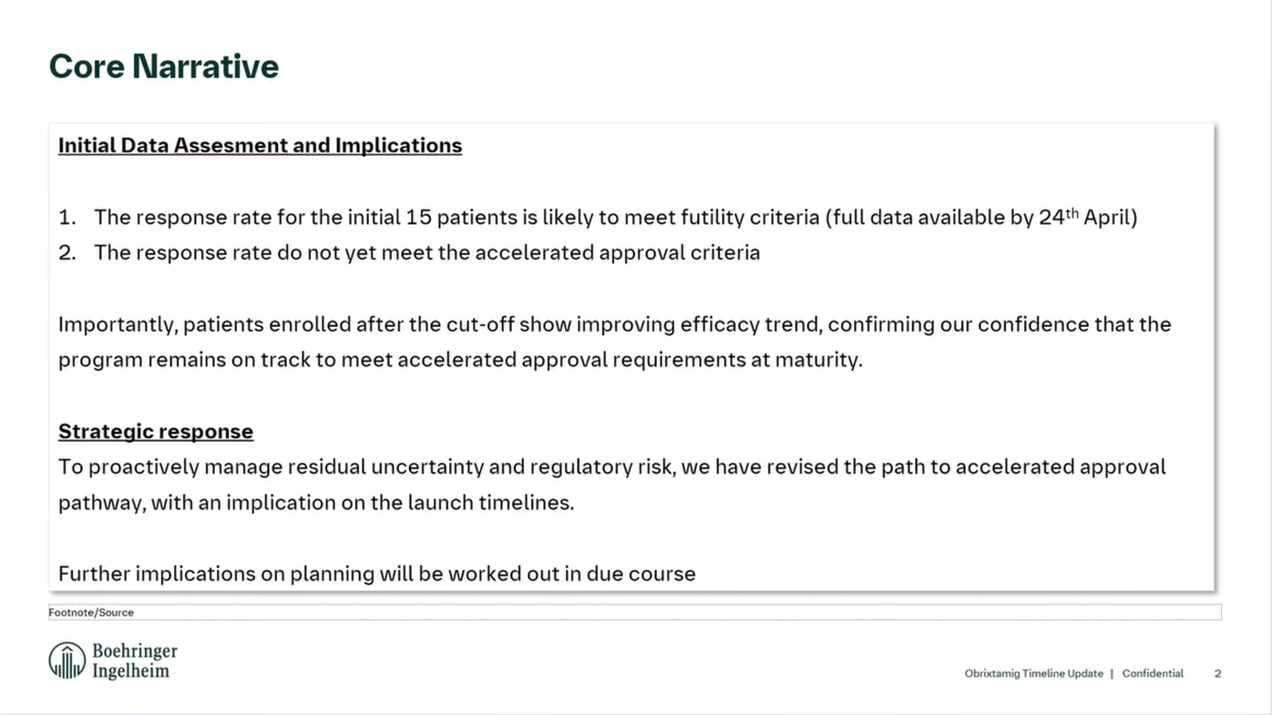

Slide 26
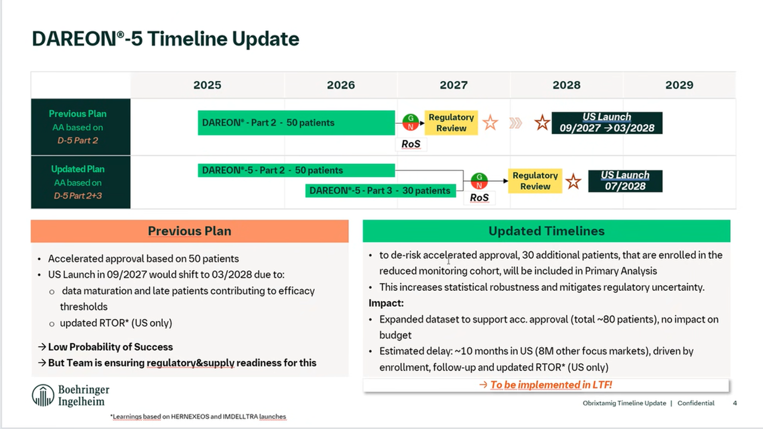

Slide 27
1438-0005 DLL3/CD3 epNEC dated on 16Apr 2026 (Global recruitment status)
Cut-off date：16Apr 2026
Total Screened：243
Total Enrolled：33
Total Screen Failure：161
In Screening 01：47
In Screening 02： 2
Screen failure rate：82.99%
Total Screened Planned = 125
Total Randomized Planned = 50
Part 2
Months | Mar-25 | Apr-25 | May-25 | Jun-25 | Jul-25 | Aug-25 | Sep-25 | Oct-25 | Nov-25 | Dec-25 | Jan-26 | Feb-26 | Mar-26 | Apr-26 | May-26 | Jun-26 | Jul-26 | Aug-26
Patients Enrolled (Planned) | 0 | 2 | 3 | 5 | 7 | 9 | 11 | 15 | 18 | 22 | 25 | 29 | 33 | 37 | 41 | 44 | 48 | 50
Patients Enrolled (Actual) | 0 | 0 | 0 | 0 | 1 | 1 | 5 | 11 | 13 | 15 | 20 | 27 | 30 | 33
Patient Screened(Planned) | 1 | 4 | 8 | 12 | 16 | 22 | 28 | 36 | 44 | 53 | 62 | 71 | 81 | 90 | 99 | 108 | 118 | 125
Patient Screened(Actual) | 0 | 0 | 1 | 2 | 12 | 22 | 50 | 77 | 108 | 143 | 162 | 214 | 237 | 243
Clinical Development
and Operations

Slide 28
1438-0005 DLL3/CD3 epNEC dated on 16Apr 2026 (Asia recruitment status)
Part 2
Asia
China
Asia Recruitment Plan:
CHN: 5 pts ( completed)
JPN: 6 pts
KOR: 4 pts
Asia Recruitment Status:
Cut-off date：16Apr 2026
Total Screened：58
Total Enrolled：5(CHN)+4(JPN)
Total Screen Failure：39
In Screening 01：10(JPN)
In Screening 02: 0
Screen failure rate：81.25%
Japan
Korea
Months | Jan-26 | Feb-26 | Mar-26 | Apr-26 | May-26 | Jun-26 | Jul-26
China Screen(Actual) | 13 | 13 | 13 | 13
China Recruitment(Actual) | 5 | 5 | 5 | 5
Japan Screen(Actual) | 19 | 28 | 39 | 40
Japan Recruitment(Actual) | 0 | 1 | 2 | 4
Korea Screen(Actual) | 5 | 5 | 5 | 5
Korea Recruitment(Actual) | 0 | 0 | 0 | 0
Asia Screen(Actual) | 37 | 46 | 57 | 58
Asia Recruitment(Actual) | 5 | 6 | 7 | 9
Clinical Development
and Operations

Slide 29
Obrixtamig (DLL3/CD3 TcE) – 1L SCLC (obrix+atezo+EP vs. atezo+EP)
We are here
2025 |  | 2026 |  |  |  | 2027 |  |  |  | 2028 |  |  |  | 2029 |  |  |  | 2030
Q3 | Q4 | Q1 | Q2 | Q3 | Q4 | Q1 | Q2 | Q3 | Q4 | Q1 | Q2 | Q3 | Q4 | Q1 | Q2 | Q3 | Q4 | H1
Ph3-
1438-0012
Dareon-Lung-1
15 Sep 2025
Mar 2026
Jun 2027
Q4 2028
Jan 2029
May 2029
Ph3, N=670
FDA interaction
SIV
LPI
Key results
NDA sub.
NDA app.
Japan screened first patient on 13Apr 2026.
Aug 2025
Nov 2025
May 2026
Jun 2027
Q4 2028
Feb 2029
Dec 2029
CTA Review + EC + HGRAC + 1st SIV
Ph3, N=116 (Inc.TW20+HK2)
Ph3-
1438-0012
Dareon-Lung-1
PreIND Sub
CTA Sub
1st SIV
LPI
Key results
NDA sub.
NDA app.
First site(宁波大学附一) was initiated on 17Apr 2026. 上海胸科 was the second one initiated on 20Apr 2026. Up to date, 4 sites initiated.
Investigator meeting was scheduled on 25 Apr 2026 in Shanghai.
29

Slide 30
Obrixtamig (DLL3/CD3 TcE) – 1L epNEC (obrix+EP vs. EP)
We are here
2025 |  | 2026 |  |  |  | 2027 |  |  |  | 2028 |  |  |  | 2029 |  |  |  | 2030
Q3 | Q4 | Q1 | Q2 | Q3 | Q4 | Q1 | Q2 | Q3 | Q4 | Q1 | Q2 | Q3 | Q4 | Q1 | Q2 | Q3 | Q4 | H1 | H2
21 Nov 2025
Jan 2029
Jul 2029
Jun 2026
Jan 2028
Sep 2028
Jun 2029
Ph3-
1438-0011
Dareon-Nec-1
Ph3, N=390
FDA interaction
SIV
LPI
Key results
NDA sub.
NDA app.
NDA sub.
Global updated the trial timeline due to the recruitment rate increased.
NDA submission date shifted from Jun 2029 to Jan 2029.
Aug 2025
Jan 2026
Jul 2026
Jan 2028
Sep 2028
Feb 2029
Dec 2029
CTA preparation
CTA Review + EC + HGRAC + 1st SIV
Ph3, N=~60
Ph3-
1438-0011
Dareon-Nec-1
Kick-off
CTA Sub
1st SIV
LPI
Key results
NDA sub.
NDA app.
We received CTA approval on 14Apr 2026. Only general comments left at CTN.
14 sites completed GCP submission, 6 sites completed EC submission and 3 EC approval obtained
IM meeting was planned in June. Details will be checked with Prof.Shen after Labor Day.
30

Slide 31
Obrixtamig (DLL3/CD3 TcE) – 1L/2L SCLC(obrix+BNT327+chemo)
We are here
2025 |  | 2026 |  |  |  | 2027 |  |  |  | 2028 |  |  |  | 2029 |  |  |  | 2030
Q3 | Q4 | Q1 | Q2 | Q3 | Q4 | Q1 | Q2 | Q3 | Q4 | Q1 | Q2 | Q3 | Q4 | Q1 | Q2 | Q3 | Q4 | H1 | H2
20 Jan 2026
Jun 2026
Sep 2027
Ph Ib/II-
1438-0035
BOND
Ph Ib/II, N≈60
FDA interaction
SIV
LPI
17 Mar 2026
The contract between BioNtech and BI has been signed on 27 Mar.
Submitted US IND on 3 Apr 2026.
CTP final
Jan 2026
May 2026
Oct 2026
Sep 2027
CTA Prep.
CTA Review + EC + HGRAC + 1st SIV
Ph Ib/II, N=5
Ph Ib/II-
1438-0035
BOND
Frontloading
preparation
CTA Sub
1st SIV
LPI
CTA will be submitted in mid-late May 2026, TBD by BioNtech.
Prof.Lu agreed to be national leading PI.
31

Slide 32
Obrixtamig (DLL3/CD3 TcE) – 1L/2L SCLC(obrix+DLL3-ADC+chemo)
We are here
2025 |  | 2026 |  |  |  | 2027 |  |  |  | 2028 |  |  |  | 2029 |  |  |  | 2030
Q3 | Q4 | Q1 | Q2 | Q3 | Q4 | Q1 | Q2 | Q3 | Q4 | Q1 | Q2 | Q3 | Q4 | Q1 | Q2 | Q3 | Q4 | H1 | H2
6 Apr 2026
Sep 2026
Dec 2027
Ph Ib/II-
1438-0036
Zorro
Ph Ib/II, N≈60
CTA
SIV
LPI
24 Mar 2026
The contract between BI and ZaiLab has been signed in early Mar 2026.
Submitted US IND on 8Apr 2026.
CTP final
Mar 2026
May 2026
Nov 2026
Dec 2027
CTA Prep.
CTA Review + EC + HGRAC + 1st SIV
Ph Ib/II, N=4
Ph Ib/II-
1438-0036
Zorro
Kick-off
CTA Sub
1st SIV
LPI
CTA documents are under preparation and being reviewed by global team.
Target to submit CTA on 15May.
Prof.Lu agreed to be national leading PI.
32

Slide 33
Brigimadlin (BI 907828, MDM2/p53)

Slide 34
Brigimadlin (MDM2/p53 antago.) – Rollover study Development Plan
We are here
2024 | 2025 |  |  |  | 2026 |  |  |  | 2027 |  |  |  | 2028 |  |  |  | … |  | 2034
Q4 | Q1 | Q2 | Q3 | Q4 | Q1 | Q2 | Q3 | Q4 | Q1 | Q2 | Q3 | Q4 | Q1 | Q2 | Q3 | Q4 | H1 | H2 | H1 | H2
Dec 2024
Dec 2034
Ph2-
1403-0032
Ph2
SIV
LPC
Apr 2025
Oct 2025
CTA Review + EC + HGRAC + 1st SIV
Ph2, N=2
Ph2/3-
1403-0032
CTA Sub
1st SIV
CTA was approved on 27 Aug 2025.
34

Slide 35
Early Assets
CD137/FAP (BI 765179)
STING Agonist (BI 1703880)
LY6K-HLA/CD3 (BI 3822971)

Slide 36
CD137/FAP (BI 765179)

Slide 37


CD137/FAP – HNSCC/NSCLC Development Plan
We are here
2024 |  |  |  | 2025 |  |  |  | 2026 |  |  |  | 2027 |  | 2028 |  | 2029
Q1 | Q2 | Q3 | Q4 | Q1 | Q2 | Q3 | Q4 | Q1 | Q2 | Q3 | Q4 | H1 | H2 | H1 | H2
Global
Lean PoCP
(Jun 2024)
PoC
(Jul 2026)
Mar 2025
Aug 2025
Jan 2026
Feb 2026
Ph1-1463.1b
HNSCC
Phase 1b N=60
FPI
Feb 2032
Futility analysis
LPI
Primary analysis
NDA FA
Ph2/3
1L R/M HNSCC
Ph1b/2 1463-0002
in 1L NSCLC
Ph 3 pivotal (combi pembro) for 1L NSCLC
Primary analysis is planned for PoC release in July 2026.
GO/No GO criteria is updated with ORR from 40% to 36% based on the ORR of Pembro+chemo in 1L HNSCC with CPS* ≥1
1L NSCLC development is under planning.
Ph1-1463.1b
NSCLC
Ph 3 pivotal (combi pembro) 1L R/M HNSCC
China
Aug 2024
Feb 2025
24Nov2025
Ph1-1463.1b
HNSCC
CTA Review + EC + HGRAC + 1st SIV
Phase 1b N=7
CTA Sub
1st SIV
LPI
7 Chinese patients were enrolled (1CR, 2 PRs, 2 SDs and 2PDs).
*CPS: Combined positive score

Slide 38
CD137xFAP Clinical Development in 1L NSCLC PD-L1 positive
Nov 24
Jul 11
Dec 19
Feb 19
Mar 17
Oct 5
Feb 9
Sep 2
Today
2024
 | 2026 | 2027 | 2028 | 2029 | 2030 | 2031 | 2032 | 2033/2034
1L NSCLC TPS ≥ 50% 1L NSCLC TPS 1-49%
Randomised Ph II combo Pembro vs Pembro (PFS) N = 145
RoFD
Ph III combo Pembro (PFS/OS) N = TBD
FA US
PoC
G
N
G
GO
PFS HR <0.75
IA PFS
PA OS
N
If Ivo is new SOC
Seamless Ph II/III combo PD-1xVEGF BsAb
Stage 1: Safety run-in (N = 12-18)
Stage 2: Randomised Phase II (PFS)
Stage 3: Randomised Phase III (OS)
Combo PD-1xVEGF Ab preclinical evidence
G
FA US
N
Jan 13 - Oct 23
Ph I triple combo Pembro + chemo
Safety run-in (RP2D) + dose expansion (ORR/DOR) N = 30
Ph II/III triple combo Pembro + chemo
Stage 1: Randomised Phase II (PFS)
Stage 2: Randomised Phase III (OS)
May 11 - Aug 4
Jun 24 - Jul 21
Other FAP+ tumors
G
Ph Ib/II combi SOC
G
Ph III Combi SOC
N
N
Ivonescimab mono: TPS ≥50%: ORR 60%; PFS: 11.1 mon. TPS 1-49%: ORR 43%; PFS: 8.0 mon. TPS ≥1%: ORR 50%; PFS: 11.1 mon. DoR: NR.
Ivonescimab+CT: TPS ≥1%: ORR 72%; PFS: 11.1 mon. DoR 12.5 m
Pembro mono: TPS ≥50% (KN-024): non-sq: ORR 46%, mPFS 7.7m. Sq: ORR 46%, mPFS 8.3m; TPS 1-49%: ORR 31%; PFS: 5.4 mon
Pembro+CT: TPS ≥50%: non-sq (KN-189)​ : ORR 62%, mPFS 11.3m ; Sq (KN-407)​ : ORR 64%, mPFS 8.3m.
TPS 1-49%: non-sq : ORR 50%, mPFS 9.4m ; Sq: ORR 54%, mPFS 8.2m. TPS ≥1%: mPFS 5.6m; ORR 37.3%; DOR 26.5m​
Notes:
Benchmark in TPS ≥50%
Pembro mono : non-sq mOS 26.3m, mPFS 7.7.m, ORR 46%. Squamous: mOS 19.9m; mPFS 8.3m
Future benchmark: Ivonescimab (HARMONI-7, PCD: 4/2028). Approved in China (HARMONi-2) PFS 11.1m vs 5.8m, HR 0.51
Benchmark in TPS <50%:
Pembro + chemo: non-sq : mOS 19-22m ; mPFS 8-9m ; ORR 44-56%. squamous: mOS 18m; mPFS 8.2m
Future benchmark Ivonescimab+Chemo (global HARMONI-3, PCD: 4/2028). Approved in China (HARMONI-6 all comers, PFS 11.1m vs 6.9m HR 0.6) and in TPS ≥1%.
TPS ≥50%: mOS 26.3m; mPFS 7.7m; ORR 45%; DOR 29m (Keynote-024)​
TPS ≥1%: mOS 16.4m; mPFS 5.6m; ORR 37.3%; DOR 26.5m (Keynote-042)​
KN-042: Pembro mono in TPS >=50%: ORR 39%, mPFS 6.5 mo, mOS 20 mo
KN-407: Pembro chemo in TPS >=50%: ORR 60%, mPFS 8.3 mo, mOS 23.3 mo
KN-189: Pembro chemo in TPS >=50%: ORR 62%, mPFS 12.8 mo, mOS 29.6 mo

Slide 39
Go NoGo Scenarios for initiation of a Ph. 2 study in 1L NSCLC based on ORR in 1L HNSCC
PoC:
ORR ≥36%
Planned July 2026
  No Go:
  <40% (<12 PRs of 30 pts) <36% (<11 PRs of 30 pts)
  Go:
  40 36-49% (12 11-14 PRs of 30 pts) → must justify resource investment
  Super Go:
  ≥50% (≥15 PRs of 30) → accelerate Ph2 in 1L NSCLC TPS high/Low

Slide 40
1L HNSCC CPS ≥1: SOC and future SOC
PoC:
ORR ≥36%
 | Population | ORR | PFS (mo) | OS (mo)
Pembro + chemo | CPS ≥1 | 36% | 4.9 | 13.6 vs 11
 | CPS ≥20 | 44% | 6 | 14.7 vs 11
Pembro mono | CPS ≥1 | 19% | 3.2 | 12.3
 | CPS ≥20 | 23.3% | 3.4 | 14.9
Potential future SOC:
Petosemtamab (anti EGFR/LGR5, Merus/Genmab) + Pembro: estim. launch date 01/27
combi with pembro in CPS ≥1 (mainly HPV-) 1L HNSCC pts in a Ph 1/2 trial (n=43) showed
cORR 63%
mPFS 9.0m
12-mOS rate 79%
Notes:
Ficerafusp alfa (EGFR x TGFb, Bicara Ther.) + Pembro may launch in Q1 2028 for HPV- disease; Ph 1 trial data (n=28) ORR 54%, mPFS 9.9m and mOS 21.3m.
Amivantamab (EGFR x c-MET, Janssen) Ph1/2 data in 2L HNSCC (ORR 45% with DOR of 7.2m and mPFS 6.8m); a Ph 3 trial in combination with Pembro and carboplatin planned, estim. launch Q4/2029.
POC: 36% = 11 OR /30pts
Extreme regimen cetux/platin/5FU: ORR 36% PFS 5.1mo OS 10.7mo
LGR5, or Leucine-rich repeat-containing G-protein coupled receptor 5, is a transmembrane receptor that plays a significant role in regulating stem cell function and is a marker for adult stem cells in various tissues, particularly in the intestinal epithelium. It is involved in the Wnt signaling pathway, which is essential for maintaining stemness and controlling cell fate.

Slide 41
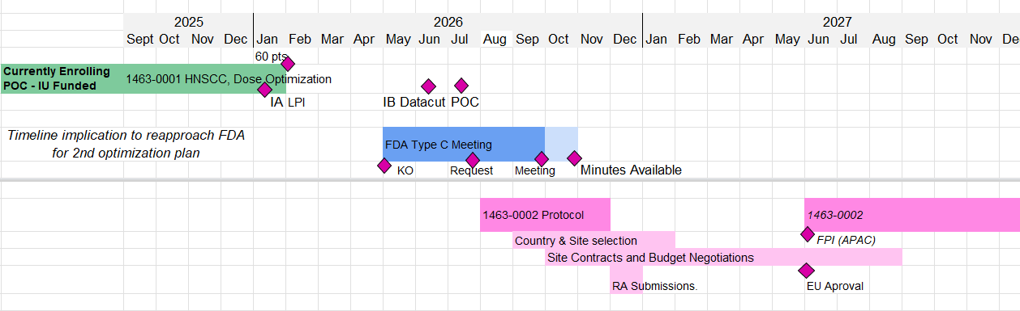
Timelines for 1463-0002 Start-Up and FPI Milestones
Resource Requests
BUPC

Slide 42
STING Agonist (BI 1703880)

Slide 43
Systemic STING ago. FR – NSCLC Development Plan
We are here
2025 |  |  |  | 2026 |  |  |  | 2027 |  |  |  | 2028 |  |  |  | 2029 |  | 20230
Q1 | Q2 | Q3 | Q4 | Q1 | Q2 | Q3 | Q4 | Q1 | Q2 | Q3 | Q4 | Q1 | Q2 | Q3 | Q4 | H1 | H2 | H1 | H2
Ph2-
1480-0002
Nov 2026
TBD
Ph2, N=80
SIV
LPI
Dose escalation is still ongoing.
The key priority is ensuring robust decision-making with available data in June.
Target remains July for submission of updated 1480.2 protocol.
Final CTP: 27-May-26
Aug 2026
Feb 2027
TBD
Ph2-
1480-0002
CTA Review + EC + HGRAC + 1st SIV
Ph2, N=12
CTA Sub
1st SIV
LPI
CTA submission: Aug 2026 (30days pilot?)
43

Slide 44
LY6K-HLA/CD3 (BI 3822971)

Slide 45
LY6K-HLA/CD3 FiH Ph1 Timeline
We are here
2026 |  |  |  | 2027 |  |  |  | 2028 |  |  |  | 2029 |  | 2030 |  | 2031 |  | 2032
Q1 | Q2 | Q3 | Q4 | Q1 | Q2 | Q3 | Q4 | Q1 | Q2 | Q3 | Q4 | H1 | H2 | H1 | H2 | H1 | H2 | H1 | H2
Sep 2026 ← Nov
Oct 2029
Apr 2030
Sep 2031
Ph1 FiH
2015-0001
CTA Sub
30Apr2026
Ph 1a mono DE (N = 89 / 137, 12 sites)
Ph 1b mono expansion
PoC
Feb2032
FDA pre-IND WRO
06Mar 2026
FSS
LPI
FSS
LPI
sqNSCLC
N = 30 / 60
Steering committee meeting on 24Apr2026
May 2026
Aug 2026
Feb 2027
Oct 2029
Apr 2030
Sep 2031
Pre-IND
CTA Review + EC + HGRAC + 1st SIV
Ph 1a mono DE (N = 89 / 137, 12 sites)
Ph 1b mono expansion
Pre-IND Sub
CTA Sub
SIV
LPI
FSS
LPI
China assessment is completed.
Note: Pre-IND submission plan based on assumption that package is ready now.
45

Slide 46
01
02
03
Regulatory and Legal feasibility
Clinical and Operational Feasibility
Patient Selection Feasibility
04
05
06
Biomarker and Sampling Handling
CMC and IMP Supply
CPS

Slide 47
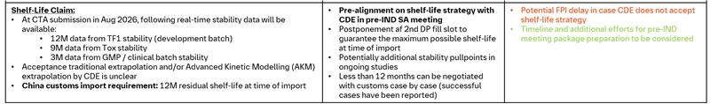
China Feasibility Assessment CMC - Summary
Potential Gap | Mitigation Actions | Criticality No / Low / Medium / Significant / High

Slide 48
PMS & RWE Studies

Slide 49
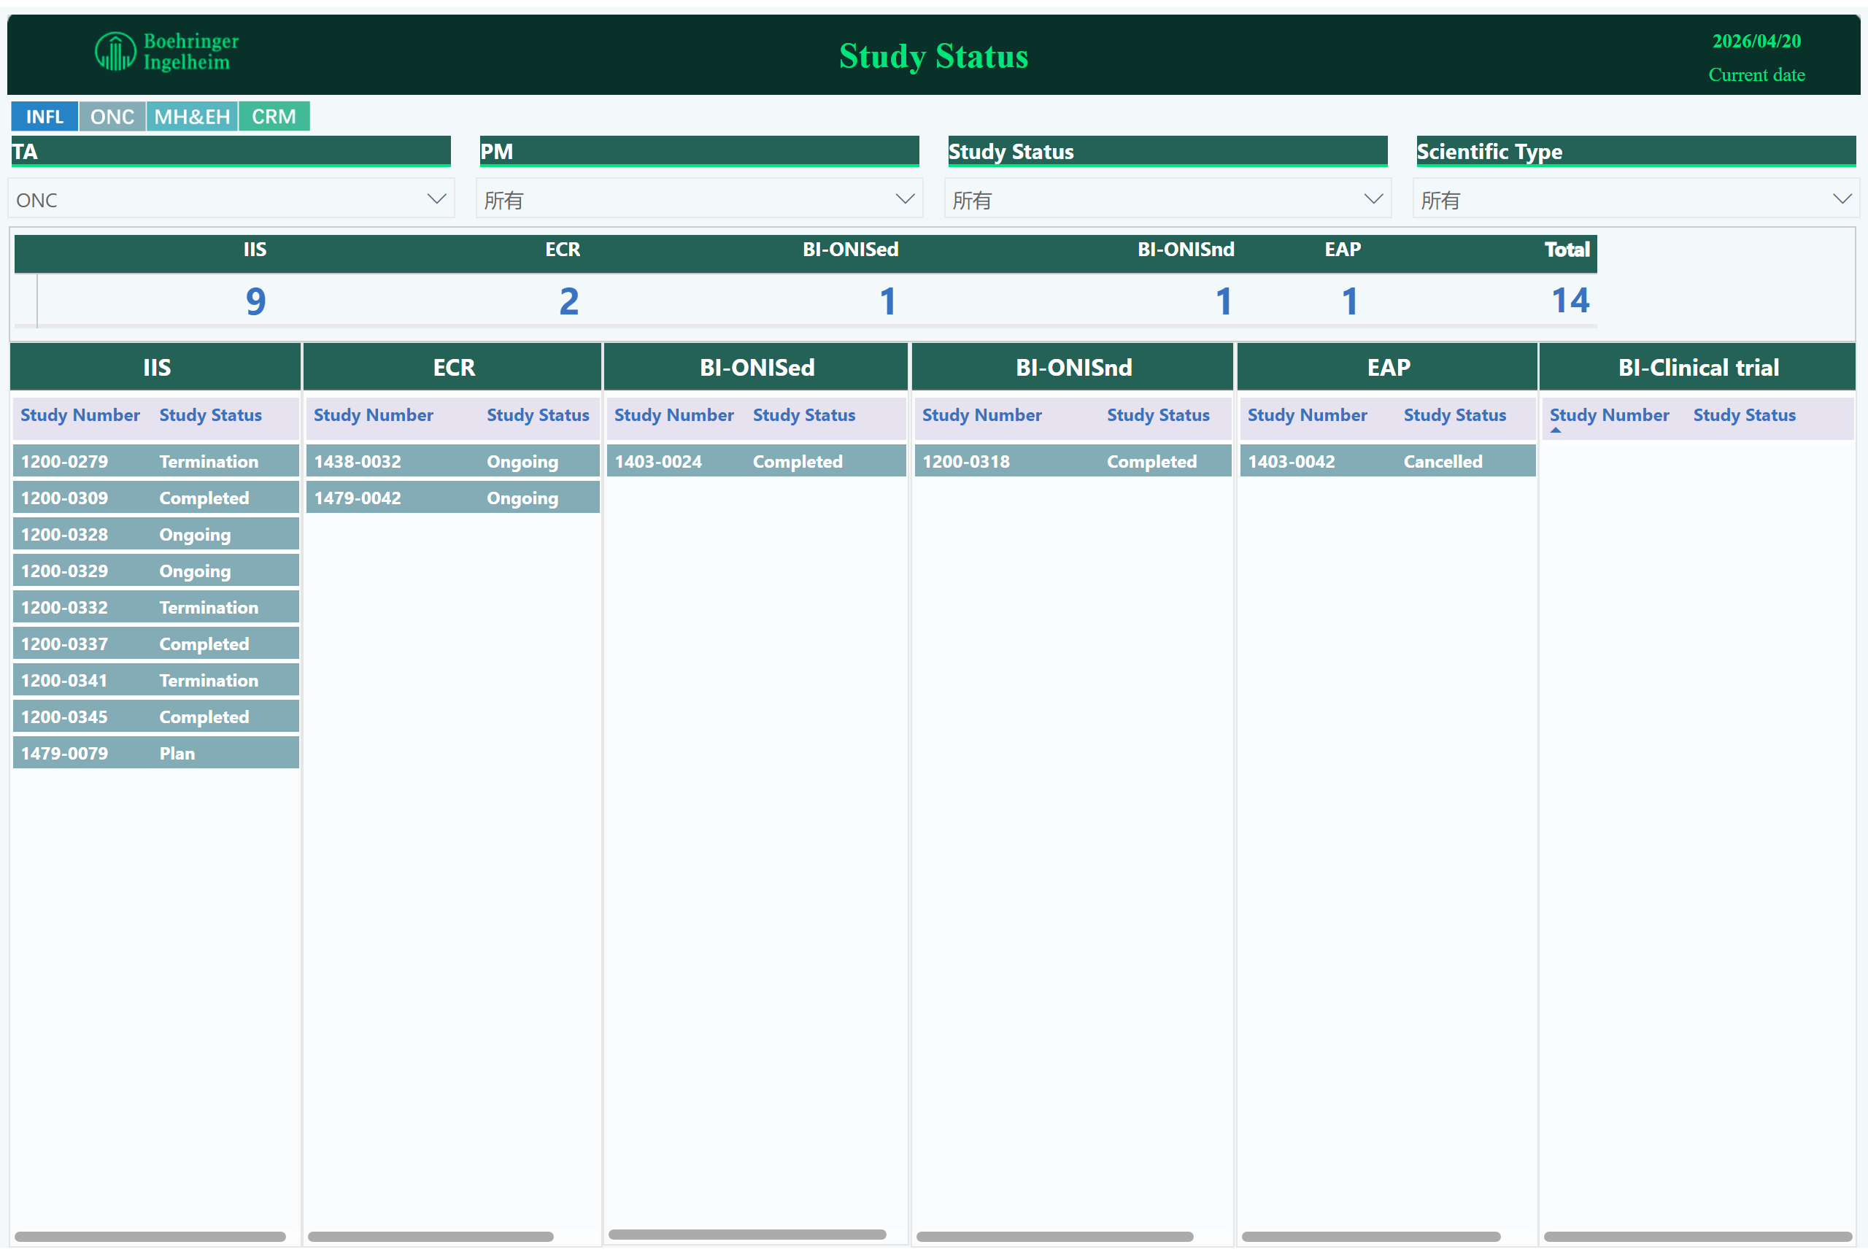
Study Status
TA ONCO Portfolio Summary - PMS Studies
1438- Obrixtamig
1479- Zongertinib
1200- Afatinib
Notes:
ECR
No alt text provided
pivotTable
No alt text provided
image
No alt text provided
textbox
No alt text provided
textbox
No alt text provided
card
No alt text provided
IIS
No alt text provided
slicer
No alt text provided
slicer
No alt text provided
slicer
No alt text provided
slicer
No alt text provided
BI-ONISed
No alt text provided
BI-ONISnd
No alt text provided
EAP
No alt text provided
BI-Clinical trial
No alt text provided
image
No alt text provided

Slide 50
Mature Product/PMS Overview - ONCO
Product/Study | Indication | Study type (Study no.: FPI-LPO,CTR) | Current Status | Next Mile-stone | Key Updates
Zongertinib (Epidemiology and Real-world Treatment Patterns of Advanced NSCLC Patients with HER2 Mutation in China) PEK University, Prof. ZHAN Siyan | NSCLC | ECR(1479-0042) Dec2025-Apr 2026, Mar 2027 | Data collection ends （Mar 2026） | Data analysis （May 2026） | CEC endorsed in Dec 2024. Global released was completed on 24 Mar 2025.Kick off meeting was held on 24Apr. Protocol was approved in Aug. The contract was signed on 17Sep. Data collection started on 26Nov 2025. Data analysis is ongoing.
Zongertinib (The SEQUENTIAL-HER2 Study: A Prospective, Multicenter Study Evaluating First-line Zongertinib followed by ADCs in Patients with HER2 TKD-mutated Advanced NSCLC ) CTONG/Guangdong General Hospital, Prof. WU Yilong | NSCLC | IIS(1479-0079) Dec2026-May 2030, Oct 2030 | Global Release (25Mar 2026) | Protocol submitted to Lectrona （Apr 2026） | Got global release on 25Mar 2026. The contract template is under CTONG reviewing. The protocol is under development.
Obrixtamig (Epidemiology of Neuroendocrine Carcinomas (NECs) in China) PEK University, Prof. WANG shengfeng | NEC&SCLC | ECR（1438-0032） Jan 2026- Dec 2026, Oct 2027 or Mar 2026-May 2027, Mar 2028 | Data collection starts （26Jan 2026） | Data collection ends （Dec 2026） | Local CEC endorsed in Oct 2024. 1st round hybrid review was completed on 5Nov, and the final decision is "Eligible for Re-Submission. The kickoff meeting was held on 2Sep. The contract was signed on 21Sep. The protocol was approved on 6Nov 2025. Got EC approval letter on 25Nov 2025. Data collection started on 26Jan 2026.
Afatinib (Neoadjuvant afatinib therapy for resectable stage IIIA, IIIB-N2 EGFR mutation-positive lung adenocarcinoma) SHA Pulmonary hospital, Prof. Zhang Peng | Non-SqCC NSCLC Neoadjuvant | IIS (1200-0328): Jul.2020 - May.2022(stage 1), Apr.2026 (stage 2), Sep.2026 | Follow up (Apr 2026) | LPO (Apr 2026) | Enrollment completion on 9Feb2022 ,total 47 patients enrolled primary endpoint (stage 1) results has reached: Abstract has oral presented at 59th STS done in Jan 2023，Report accepted by Nature communications on 26July2023. DIM report submitted successfully in Aug2023 The investigator requested to extend study period from 30Sep 2025 to 30Sep 2026 and got CEC endorsement. Stage 2 follow-up is on track.
Afatinib (Neoadjuvant afatinib therapy for resectable stage IIIA, IIIB-N2 EGFR mutation-positive lung adenocarcinoma) Huashan hospital, Prof. Zhao Yao | Chordoma | IIS (1200-0329): Oct.2022 – Jan.2026, July2026 | LPO (30Jan 2026) | DBL (Apr 2026) | Clinical trail agreement fully signed, SIV:30Sep2022（sample size: 20) Actual recruit/ Planned recruit: 15/15 (by 31Jan 2025)​ FPI: 26Oct2022, LPI: 31Jan 2025 Follow-up was completed on 30Jan 2026

Slide 51
Thank You!

